Slide 1


Software Security
SC359
Lec4 SOA architecture
By:
Dr. Hussien M. Sharaf
Email: dr.sharaf@from-masr.com

Slide 2
2. Customized architecture
New 8-10-2022
Logic/Domain layer: is a collection of dynamic stored procedures that can rebuild their behavior at run time based on parameters passed to them. Each business entity has one stored procedure that gathers all its operations.
N-Tier Architecture
Presentation/UI layer
Model
Domain layer
User

Slide 3
modularized architecture for Data migration
5-Nov-2022
Data Channel
Data
Source
Multi thread
API/ ODBC/ DB model
View
Controller
Driver
Exporter
Logging
Data
Destination
User

Slide 4
Enterprise components and architectures (Cont.)
The SOA infrastructure is composed of the following elements as shown in figure 12:
Service: This is essentially a contract: it defines all interfaces and the pre- and postconditions.
Provider: This is the software entity that implements the service; it accepts and executes requests from consumers.
Consumer (or requester or client): This is the software entity which calls a service provider to request a service.
Registry (or locator): This is a software entity, which allows the lookup of services, service providers and their location – in other words it allows the service to be found.
Dr. Hussien M. Sharaf
4

Slide 5
XML vs JSON
Both are ways for passing values in form of (key, Value) pair allowing recursive data structures.
JSON: JavaScript Object Notation.
JSON is text, written with JavaScript object notation.
<employees> <employee> <firstName>John</firstName> <lastName>Doe</lastName> </employee> <employee> <firstName>Anna</firstName> <lastName>Smith</lastName> </employee> <employee> <firstName>Peter</firstName> <lastName>Jones</lastName> </employee> </employees>
{
"Name": "crunchify.com",
"Author": "App Shah",
"Company List": [
"Compnay: eBay",
"Compnay: Paypal",
"Compnay: Google"
]
}

Slide 6
Example1: Calling web API
C:\>>pip install requests
# importing the requests library
import requests
# api-endpoint
URL = "http://maps.googleapis.com/maps/api/geocode/json"
# location given here
location = “Suez university"
# defining a params dict for the parameters to be sent to the API
PARAMS = {'address':location}
# sending get request and saving the response as response object
r = requests.get(url = URL, params = PARAMS)
Making a Get request
https://www.geeksforgeeks.org/get-post-requests-using-python/

Slide 7
Creating a web API in Python
Don’t we need a web server to let the API settle on it?
How can we direct our calls to the Web server and receive responses?
pip install flask
Flask: is a lightweight web application framework. It is designed to make getting started quick and easy, with the ability to scale up to complex applications.
https://flask.palletsprojects.com/en/1.1.x/quickstart/#a-minimal-application

Slide 8
Ex1. Quickstart to flask
from flask import Flask
app = Flask(__name__)
@app.route('/')
def hello_world():
return 'Hello, World!’
WebHost at : abc.com

Slide 9
Ex1.2. Quickstart to flask
from flask import Flask
app = Flask(__name__)
@app.route(‘/helloAgain')
def hello_again():
return 'Hello, World!’
WebHost at : abc.com/helloAgain

Slide 10
QuickStart to flask
First we imported the Flask class.
Next we create an instance of flask application. The first argument is the name of the application’s module or package.
We then use the route() decorator to tell Flask what URL should trigger our function.
The function is given a name which is also used to generate URLs for that particular function and returns the message we want to display in the user’s browser.

Slide 11
QuickStart to flask
To run the application
Now head over to http://127.0.0.1:5000/, and you should see your hello world greeting.
C:\path\to\app>set FLASK_APP=hello.py

Slide 12
Ex2. API reading from DB
from flask import Flask, request
from flask_restful import Resource, Api
from sqlalchemy import create_engine
from json import dumps
from flask.ext.jsonpify import jsonify
db_connect = create_engine('sqlite:///chinook.db')
app = Flask(__name__)
api = Api(app)
class Employees(Resource):
def get(self):
conn = db_connect.connect() # connect to database
query = conn.execute("select * from employees") # This line performs query and returns json result
return {'employees': [i[0] for i in query.cursor.fetchall()]} # Fetches first column that is Employee ID

Slide 13
Ex2. API reading from DB
class Tracks(Resource):
def get(self):
conn = db_connect.connect()
query = conn.execute("select trackid, name, composer, unitprice from tracks;")
result = {'data': [dict(zip(tuple (query.keys()) ,i)) for i in query.cursor]}
return jsonify(result)
class Employees_Name(Resource):
def get(self, employee_id):
conn = db_connect.connect()
query = conn.execute("select * from employees where EmployeeId =%d " %int(employee_id))
result = {'data': [dict(zip(tuple (query.keys()) ,i)) for i in query.cursor]}
return jsonify(result)
api.add_resource(Employees, '/employees') # Route_1
api.add_resource(Tracks, '/tracks') # Route_2
api.add_resource(Employees_Name, '/employees/<employee_id>') # Route_3
if __name__ == '__main__':
app.run(port='5002')

Slide 14

Ex2. output
http://127.0.0.1:5002/employees
shows ids of all the employees in database

Slide 15
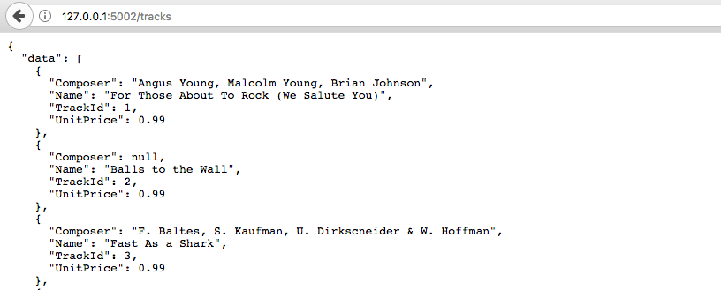
Ex2. output
http://127.0.0.1:5002/tracks shows tracks details

Slide 16
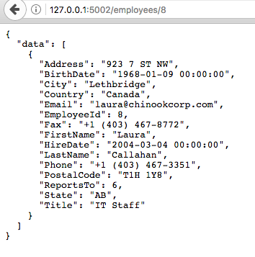
Ex2. output
http://127.0.0.1:5002/employees/8 shows details of employee whose employeeid is 8

Slide 17
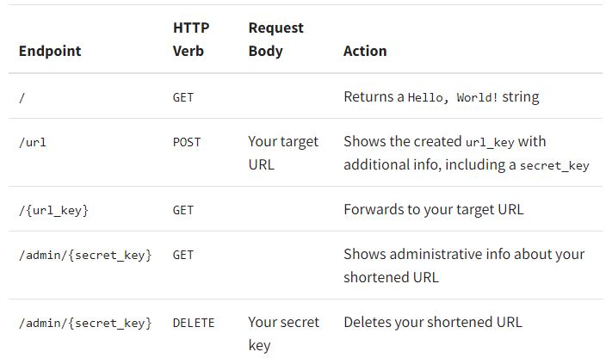
EX3: Creating a Short URL API
Endpoints and actions of your URL shortener:
https://realpython.com/build-a-python-url-shortener-with-fastapi/

Slide 18
EX3: Creating a Short URL API
Endpoints and actions of your URL shortener:
# shortener_app/main.py
import secrets
import validators
from fastapi import Depends, FastAPI, HTTPException
from sqlalchemy.orm import Session
from . import models, schemas
from .database import SessionLocal, engine
app = FastAPI()
models.Base.metadata.create_all(bind=engine)
def get_db():
db = SessionLocal()
try:
yield db
finally:
db.close()
https://realpython.com/build-a-python-url-shortener-with-fastapi/

Slide 19
EX3: Router for URL shortener:
Router for URL shortener:
@app.post("/url")
def create_url(url: schemas.URLBase):
if not validators.url(url.target_url):
raise_bad_request(message="Your provided URL is not valid")
return f"TODO: Create database entry for: {url.target_url}“
def raise_not_found(request):
message = f"URL '{request.url}' doesn't exist"
raise HTTPException(status_code=404, detail=message)
https://realpython.com/build-a-python-url-shortener-with-fastapi/

Slide 20
EX3: Router for URL shortener:
@app.post("/url", response_model=schemas.URLInfo)
def create_url(url: schemas.URLBase, db: Session = Depends(get_db)):
if not validators.url(url.target_url):
raise_bad_request(message="Your provided URL is not valid")
chars = "ABCDEFGHIJKLMNOPQRSTUVWXYZ"
key = "".join(secrets.choice(chars) for _ in range(5))
secret_key = "".join(secrets.choice(chars) for _ in range(8))
db_url = models.URL(
target_url=url.target_url, key=key, secret_key=secret_key
)
db.add(db_url)
db.commit()
db.refresh(db_url)
db_url.url = key
db_url.admin_url = secret_key
return db_url
https://realpython.com/build-a-python-url-shortener-with-fastapi/

Slide 21
EX3: Router for URL shortener:
@app.get("/{url_key}")
def forward_to_target_url(
url_key: str,
request: Request,
db: Session = Depends(get_db)
):
db_url = (
db.query(models.URL)
.filter(models.URL.key == url_key, models.URL.is_active)
.first()
)
if db_url:
return RedirectResponse(db_url.target_url)
else:
raise_not_found(request)
https://realpython.com/build-a-python-url-shortener-with-fastapi/

Slide 22
EX3: Router for URL shortener:
@app.post("/url", response_model=schemas.URLInfo)
def create_url(url: schemas.URLBase, db: Session = Depends(get_db)):
if not validators.url(url.target_url):
raise_bad_request(message="Your provided URL is not valid")
chars = "ABCDEFGHIJKLMNOPQRSTUVWXYZ"
key = "".join(secrets.choice(chars) for _ in range(5))
secret_key = "".join(secrets.choice(chars) for _ in range(8))
db_url = models.URL(
target_url=url.target_url, key=key, secret_key=secret_key
)
db.add(db_url)
db.commit()
db.refresh(db_url)
db_url.url = key
db_url.admin_url = secret_key
return db_url
https://realpython.com/build-a-python-url-shortener-with-fastapi/

Slide 23
EX3: models.py:
# shortener_app/models.py
from sqlalchemy import Boolean, Column, Integer, String
from .database import Base
class URL(Base):
__tablename__ = "urls"
id = Column(Integer, primary_key=True)
key = Column(String, unique=True, index=True)
secret_key = Column(String, unique=True, index=True)
target_url = Column(String, index=True)
is_active = Column(Boolean, default=True)
clicks = Column(Integer, default=0)
https://realpython.com/build-a-python-url-shortener-with-fastapi/

Slide 24
EX3: database.py:
# shortener_app/database.py
from sqlalchemy import create_engine
from sqlalchemy.ext.declarative import declarative_base
from sqlalchemy.orm import sessionmaker
from .config import get_settings
engine = create_engine(
get_settings().db_url, connect_args={"check_same_thread": False}
)
SessionLocal = sessionmaker(
autocommit=False, autoflush=False, bind=engine
)
Base = declarative_base()
https://realpython.com/build-a-python-url-shortener-with-fastapi/

Slide 25
def main():
from shortener_app.database import SessionLocal
db = SessionLocal()
from shortener_app.models import URL
db.query(URL).all()
if __name__ == '__main__':
main()

Slide 26
Calling web API
Calling the above code:
# extracting data in json format
data = r.json()
# extracting latitude, longitude and formatted address
# of the first matching location
latitude = data['results'][0]['geometry']['location']['lat']
longitude = data['results'][0]['geometry']['location']['lng']
formatted_address = data['results'][0]['formatted_address']
# printing the output
print("Latitude:%s\nLongitude:%s\nFormatted Address:%s"
%(latitude, longitude,formatted_address))
https://www.geeksforgeeks.org/get-post-requests-using-python/

Slide 27

Calling web API
Output:
https://www.geeksforgeeks.org/get-post-requests-using-python/

Slide 28
Example2: Calling web API
Speed test:
pip install speedtest-cli
import speedtest
def test():
s = speedtest.Speedtest()
s.get_servers()
s.get_best_server()
s.download()
s.upload()
res = s.results.dict()
return res["download"], res["upload"], res["ping"]
https://stackoverflow.com/questions/48289636/speedtest-python-script

Slide 29
Calling web API continue
def main():
# simply print in needed format if you want to use pipe-style: python script.py > file
for i in range(3):
d, u, p = test()
print('Test #{}\n'.format(i+1))
print('Download: {:.2f} Kb/s\n'.format(d / 1024))
print('Upload: {:.2f} Kb/s\n'.format(u / 1024))
print('Ping: {}\n'.format(p))
if __name__ == '__main__':
main()
https://stackoverflow.com/questions/48289636/speedtest-python-script

Slide 30
Thank you

